Slide 1
Introduction to Machine Learning ARM-206

Slide 2
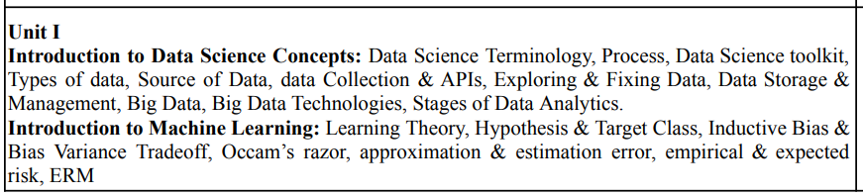
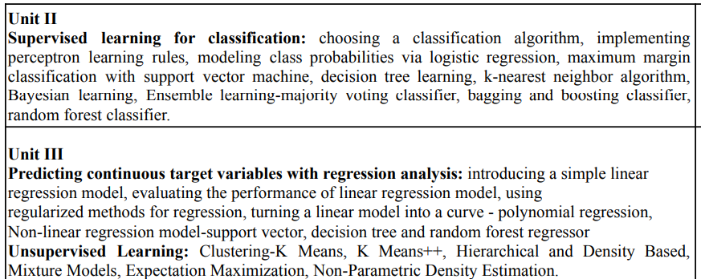
SYLLABUS

Slide 3
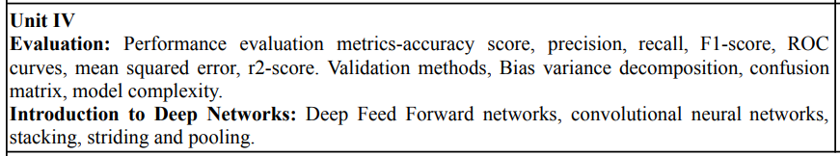
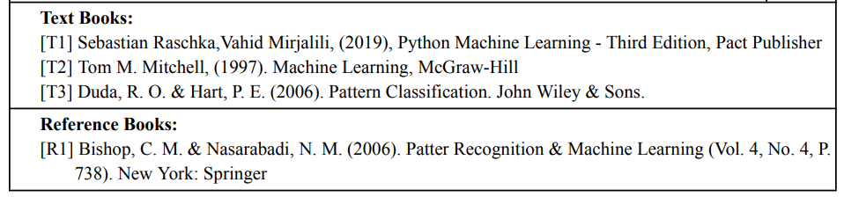
SYLLABUS

Slide 4
UNIT-1 Introduction to Data Science Concept

Slide 5
What is Data Science?
Data science is a deep study of the massive amount of data, which involves extracting meaningful insights from raw, structured, and unstructured data that is processed using the scientific method, different technologies, and algorithms.
It is a multidisciplinary field that uses tools and techniques to manipulate the data so that you can find something new and meaningful.
Data science uses the most powerful hardware, programming systems, and most efficient algorithms to solve the data related problems. It is the future of artificial intelligence. In short, we can say that data science is all about:
Asking the correct questions and analyzing the raw data.
Modeling the data using various complex and efficient algorithms.
Visualizing the data to get a better perspective.
Understanding the data to make better decisions and finding the final result.
Example:
Let suppose we want to travel from place A to place B by car. Now, we need to take some decisions such as which route will be the best route to reach faster at the location, in which route there will be no traffic jam, and which will be cost-effective. All these decision factors will act as input data, and we will get an appropriate answer from these decisions, so this analysis of data is called the data analysis, which is a part of data science.

Slide 6
What is generating so much data? •Data can be generated by –Humans, –Machines or –Humans-machines combines •It can be generated anywhere where any information is generated and stored in structured or unstructured formats

Slide 7


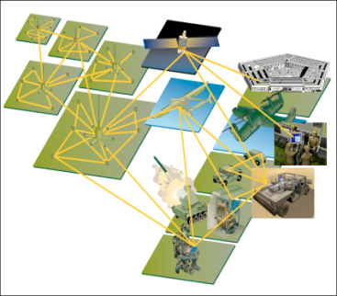
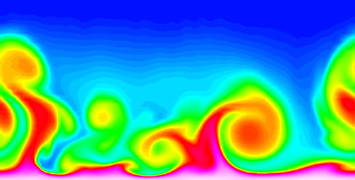
Large-scale Data is Everywhere!
There has been enormous data growth in both commercial and scientific databases due to advances in data generation and collection technologies
New mantra
You can gather whatever data
whenever and wherever possible.
Expectations
Gathered data will have value either for the purpose collected or for a purpose not envisioned.
Cyber Security
E-Commerce
Traffic Patterns
Social Networking: Twitter
Sensor Networks
Computational Simulations

Slide 8
Data Science Terminologies
Here are some common terms used in data science:-
Data: Facts, observations, or measurements that are collected and analyzed in order to gain insights or draw conclusions.
Dataset: A collection of data, usually presented in tabular form, that has been organized and formatted for analysis.
Feature: A measurable aspect or characteristic of a dataset that can be used to make predictions or gain insights.
Machine Learning: A field of study that uses algorithms and statistical models to enable computers to learn from data and make predictions or decisions without being explicitly programmed.
Regression: A statistical method used to model the relationship between a dependent variable and one or more independent variables.
Classification: A type of machine learning task where the goal is to predict a discrete label or category for a given input.
Clustering: A type of unsupervised machine learning task where the goal is to group similar data points together.

Slide 9
Data Science Terminologies contd…
Neural Network: A type of machine learning model that is inspired by the structure and function of the human brain.
Data Visualization: The use of graphical or visual representations of data to facilitate understanding and communication.
Big Data: A term used to describe extremely large and complex datasets that require specialized tools and techniques for storage, processing, and analysis.
Deep Learning: A subfield of machine learning that uses neural networks with multiple layers to learn complex patterns in data.
Model: A mathematical or computational representation of a system or process that can be used to make predictions or simulate behavior.
Algorithm: A step-by-step procedure for solving a problem or performing a task.
Overfitting: A problem in machine learning where a model is too complex and fits the training data too closely, leading to poor generalization to new data.
Underfitting: A problem in machine learning where a model is too simple and fails to capture the complexity of the data, leading to poor performance on both the training and test data.

Slide 10
Data Science Terminologies contd…
Data Cleaning: The process of identifying and correcting errors, inconsistencies, and missing values in a dataset to improve its quality and accuracy.
Data Wrangling: The process of transforming and reshaping data to make it more suitable for analysis.
Exploratory Data Analysis (EDA): The process of analyzing and summarizing a dataset to gain insights into its underlying patterns, relationships, and distributions.
Hypothesis Testing: The process of using statistical methods to test whether an observed effect or relationship in a dataset is statistically significant or due to chance.
Cross-validation: A method used to evaluate the performance of a machine learning model by splitting the data into training and testing sets and repeating the process multiple times to ensure the model is not overfitting.
Feature Engineering: The process of creating new features or modifying existing ones in a dataset to improve the performance of a machine learning model.
Model Selection: The process of choosing the best machine learning model for a given task based on its performance on a validation set.

Slide 11
Data Science Terminologies contd…
Ensemble Learning: A technique where multiple machine learning models are combined to improve their performance and reduce the risk of overfitting.
Regularization: A technique used to prevent overfitting by adding a penalty term to the cost function that penalizes complex models.
Gradient Descent: A numerical optimization algorithm used to find the optimal parameters of a machine learning model by iteratively adjusting the weights based on the gradient of the cost function.
Principal Component Analysis (PCA): A technique used to reduce the dimensionality of a dataset by identifying the most important features and projecting the data onto a lower-dimensional space.
Natural Language Processing (NLP): A field of study that deals with the interaction between computers and human language, including tasks such as text classification, sentiment analysis, and machine translation.
Deep Reinforcement Learning: A subfield of machine learning that combines deep learning with reinforcement learning to enable computers to learn from experience and make decisions in complex environments.
Unsupervised Learning: A type of machine learning where the goal is to identify patterns and structures in a dataset without using labeled data.
Semi-supervised Learning: A type of machine learning where some of the data is labeled and used to train a model, while the rest of the data is unlabeled and used to improve the model's performance.

Slide 12
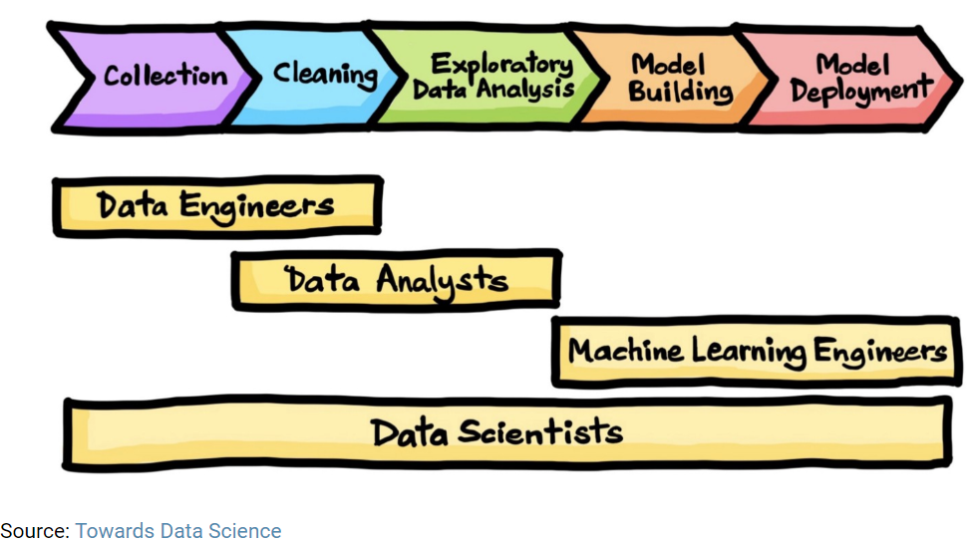
Data Science Process
The data science process is a structured approach that data scientists follow to extract insights and knowledge from data. It typically involves the following steps:
Data Science Life Cycle

Slide 13
Data Science Process
1 Problem Definition: Problem Definition: In this step, the problem to be solved is defined. This includes defining the business problem, the data needed, and the goals of the analysis.
2. Data Collection: In this step, data is collected from various sources, including internal and external sources, to obtain the data necessary to solve the problem.
3. Data Preparation: In this step, the collected data is cleaned, transformed, and preprocessed to remove errors, inconsistencies, and missing data. This ensures that the data is ready for analysis.
4. Data Exploration: In this step, exploratory data analysis (EDA) is performed to gain a better understanding of the data. This involves creating visualizations, summarizing the data, and identifying patterns and relationships in the data.
5. Data Modeling: In this step, statistical and machine learning models are developed to analyze the data and make predictions. This step involves selecting appropriate algorithms, building and testing models, and selecting the best model for the problem.
6. Model Evaluation: In this step, the performance of the model is evaluated. This involves validating the model using testing and validation datasets, assessing the model's accuracy, and identifying areas for improvement.
7. Model Deployment: In this step, the model is put into production, allowing users to interact with the model and make predictions on new data.
8. Model Monitoring: In this step, the model is monitored to ensure that it continues to perform well over time. This involves monitoring the model's accuracy, detecting any changes in the data or the environment, and updating the model if necessary.

Slide 14
Data Science Process
Data Engineer:-
A data engineer works with massive amount of data and responsible for building and maintaining the data architecture of a data science project. Data engineer also works for the creation of data set processes used in modeling, mining, acquisition, and verification.
Skill required: Data engineer must have depth knowledge of SQL, MongoDB, Cassandra, HBase, Apache Spark, Hive, MapReduce, with language knowledge of Python, C/C++, Java, Perl, etc.
Data Analyst:-
Data analyst is an individual, who performs mining of huge amount of data, models the data, looks for patterns, relationship, trends, and so on. At the end of the day, he comes up with visualization and reporting for analyzing the data for decision making and problem-solving process.
Skill required: For becoming a data analyst, you must get a good background in mathematics, business intelligence, data mining, and basic knowledge of statistics. You should also be familiar with some computer languages and tools such as MATLAB, Python, SQL, Hive, Apache Pig, Excel, SAS, R, JS, Spark, etc.

Slide 15
Data Science Process
Machine Learning Expert:-
The machine learning expert is the one who works with various machine learning algorithms used in data science such as regression, clustering, classification, decision tree, random forest, etc.
Skill Required: Computer programming languages such as Python, C++, R, Java, and Hadoop. You should also have an understanding of various algorithms, problem-solving analytical skill, probability, and statistics.
Data Scientist:-
A data scientist is a professional who works with an enormous amount of data to come up with compelling business insights through the deployment of various tools, techniques, methodologies, algorithms, etc.
Skill required: To become a data scientist, one should have technical language skills such as R, SAS, SQL, Python, Hive, Pig, Apache spark, MATLAB. Data scientists must have an understanding of Statistics, Mathematics, visualization, and communication skills.

Slide 16
Data Science Toolkit
Data Science Toolkit refers to a collection of tools and techniques used to extract insights and knowledge from data. It is used by data scientists to perform data analysis, modeling, and visualization tasks. These tools can include:-
1 Programming languages: Python and R are the two most popular programming languages used in data science, due to their robust libraries and packages for data manipulation, analysis, and visualization.
2 Data manipulation libraries: Pandas, NumPy are examples of libraries that allow data scientists to manipulate data frames, arrays, and tables.
3 Machine learning libraries: Scikit-learn, TensorFlow, Keras, and PyTorch are examples of popular machine learning libraries used for developing predictive models and deep learning algorithms.
4 Data visualization libraries: Matplotlib, Seaborn, and ggplot2 are examples of libraries that allow data scientists to create visualizations that aid in the exploration and communication of data insights.
5 Data storage and processing tools: SQL databases, Hadoop, Spark, and Apache Kafka are examples of tools that allow data scientists to store, process, and analyze large amounts of data.
6 Cloud computing platforms: Amazon Web Services, Google Cloud Platform, and Microsoft Azure are examples of cloud computing platforms that offer scalable and cost-effective solutions for storing and processing large amounts of data.
7 Big Data Technologies: Technologies like Hadoop and Spark are used to process large volumes of data in a distributed computing environment.

Slide 17
Challenges in Data Science
Data Quality and Availability: Data quality can affect the accuracy of the models developed and therefore, it is important to ensure that the data is accurate, complete, and consistent. Data availability can also be an issue, as the data required for analysis may not be readily available or accessible.
Bias in Data and Algorithms: Bias can exist in data due to sampling techniques, measurement errors, or imbalanced datasets, which can affect the accuracy of models. Algorithms can also preserve existing biases in society, leading to unfair or discriminatory outcomes.
Model Overfitting and Underfitting: Overfitting occurs when a model is too complex and fits the training data too well, but fails to generalize to new data. On the other hand, underfitting occurs when a model is too simple and is not able to capture the underlying relationships in the data.
Model Interpretability: Complex models can be difficult to interpret and understand, making it challenging to explain the model’s decisions and decisions. This can be an issue when it comes to making business decisions.
Privacy and Ethical Considerations: Data science often involves the collection and analysis of sensitive personal information, leading to privacy and ethical concerns. It is important to consider privacy implications and ensure that data is used in a responsible and ethical manner.
Technical Challenges: Technical challenges can arise during the data science process such as data storage and processing, algorithm selection, and computational scalability.

Slide 18
Types of Data
We can classify data as
Structured,
Unstructured,
Semi-structured data &
Quasi-structured data.
1) What is structured data?
Structured data is generally tabular data that is represented by columns and rows in a database.
Databases that hold tables in this form are called relational databases.
The mathematical term “relation” specify to a formed set of data held as a table.
In structured data, all row in a table has the same set of columns.
SQL (Structured Query Language) programming language used for structured data.

Slide 19
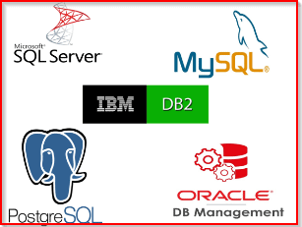
Types of Data - Structured
Relational Data
Relational databases provide undoubtedly the most well-understood model for holding data.
The simplest structure of columns and tables makes them very easy to use initially, but the inflexible structure can cause some problems.
We can communicate with relational databases using Structured Query Language (SQL).
SQL allows the joining of tables using a few lines of code, with a structure most beginner employees can learn very fast.
Examples of relational databases:
MySQL
PostgreSQL
Db2

Slide 20
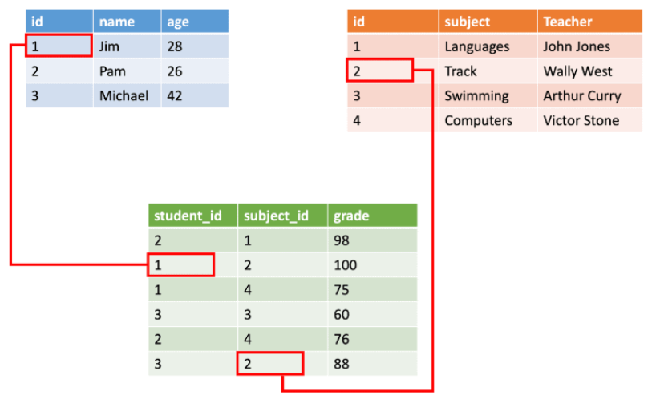
Types of Data - Structured
Examples of structured data include names, dates, addresses, credit card numbers, stock information, geolocation, and more.
Structured data is highly organized and easily understood by machine language. Those working within relational databases can input, search, and manipulate structured data relatively quickly using a relational database management system (RDBMS).

Slide 21
Types of Data - Structured
What are the characteristics of the structured data?
Data can be co-related with the relationship keys.
They can have define data types.
These data can be easily queried.
It can have well defined schema.
Structured data are well defined. You can assume your table in any RDBMS data base is a structured data. Where each column will have data type, schema defined. Even these data can have relationship with another table in database.

Slide 22
Types of Data - Unstructured
2) What is Unstructured Data?
Unstructured data is information that either does not organize in a pre-defined manner or not have a pre-defined data model.
Unstructured information is a set of text-heavy but may contain data such as numbers, dates, and facts as well.
Videos, audio, and binary data files might not have a specific structure. They’re assigned to as unstructured data.

Slide 23
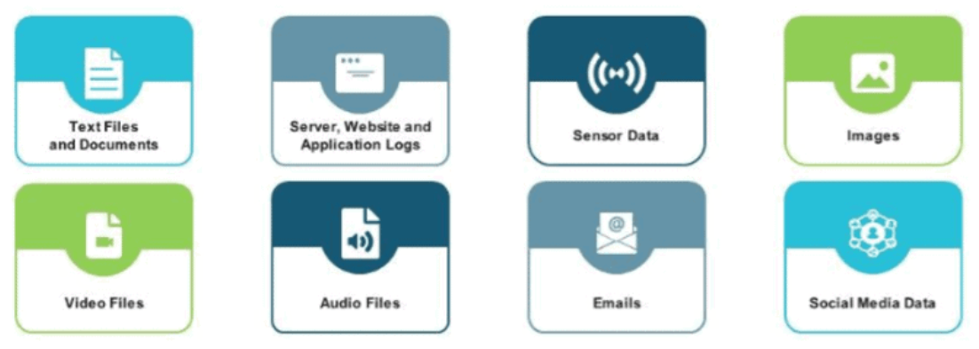
Types of Data - Unstructured
Here are a few examples where unstructured data is being used in analytics today.
Classifying image and sound. Using deep learning, a system can be trained to recognize images and sounds. The systems learn from labeled examples in order to accurately classify new images or sounds.
As input to predictive models. Text analytics — using natural language processing (NLP) or machine learning — is being used to structure unstructured text.
Chatbots in customer experience. Chatbots have been in the market for a number of years, but the newer ones have a better understanding of language and are more interactive.

Slide 24
Types of Data - Unstructured
What are the characteristics of the unstructured data?
It is difficult to query and search these data.
It is free-form of data
Audio and video files are example of unstructured data
These data is scattered and dispersed
Example of unstructured data is PDFs, Documents, and Audio and Video files. These data cannot be easily queried or searched. It requires the lot of effort to make sense out of this. You will be using pre-processing like MapReduce algorithm to transform that data in a specialized format like Avro, Parquet etc. before you can query that data.

Slide 25
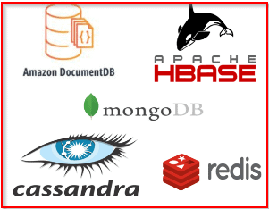
Types of Data
Non-relational databases
Non-relational databases permit us to store data in a format that more closely meets the original structure.
A non-relational database is a database that does not use the tabular schema of columns and rows found in most traditional database systems.
It uses a storage model that is enhanced for the specific requirements of the type of data being stored.
In a non-relational database the data may be stored as JSON documents, as simple key/value pairs, or as a graph consisting of edges and vertices.
Examples of non-relational databases:
Redis
JanusGraph
MongoDB
RabbitMQ

Slide 26
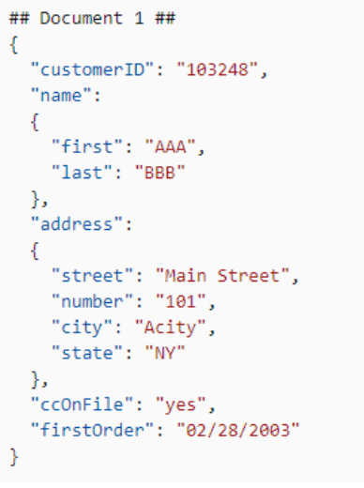
Types of Data – Semi-structured
3) What is Semi structured Data?
Semi-structured data is not the raw data and is not stored in a conventional database system. It is structured data but is not organized in a rational model like a table or an object-based graph. Semi-structured data contains tags or markers to separate semantic elements and enforce hierarchies of records and fields within the data. The entities belonging to the same class may have different attributes even though they are grouped together irrespective of the attributes’ order. Markup languages like XML, email, and EDI are forms of semi-structured data.
Semi-structured data is information that doesn’t consist of Structured data (relational database) but still has some structure to it.
Semi-structured data consist of documents held in JavaScript Object Notation (JSON) format. It also includes key-value stores and graph databases.

Slide 27
Types of Data – Semi-Structured
Semi-structured data has a defined structure, but the structure may not be as rigid as structured data. Semi-structured data typically has some flexibility in terms of the schema or data model. The data within the file may not be completely uniform. For example, a semi-structured data file may contain data in tables, with some fields having missing data or varying formats. Examples of semi-structured data include XML files and JSON documents.
For semi-structured data, data scientists can use tools such as XPath or JSONPath to extract information from the data. They can also use schema inference techniques to identify the structure of the data.

Slide 28
Types of Data – Semi-Structured
The use of semi-structured data enables us to integrate data from various sources or exchange data between different systems. Applications and systems need to evolve with time, but if we work purely with structured data, this is not possible. Let’s consider web forms. You may want to modify forms and capture different data for different users. If you are using a traditional relational database, the database schema needs to be changed each time a new field is needed, and fields can not be left empty. Semi-structured data can allow you to capture any data in any structure without making changes to the database schema or coding. Adding or removing data does not impact functionality or dependencies.
Question-: Which of the following are true for semi-structured data?
These data can be organized into a specialized repository.
These data can be easily stored in RDBMS table
These data can have associated metadata and keywords.
JSON and XML data are the example of semi-structured data
Answer: 3, 4
Explanation: Semi-structured data cannot be stored in a specialized repository like RDBMS table or Spread sheets. They are generally stored in individual documents. XML and JSON are the examples of semi-structured data. These data can have associated metadata like schema in XML and possibly keywords etc. So, you cannot say that semi-structured data cannot have schema.

Slide 29
Types of Data – Quasi-structured
4) What is Quasi-structured data?
Quasi-structured data is more of a textual data with irregular data formats. It can be formatted with effort, tools, and time. This data type includes web clickstream data such as Google searches. Other examples are pasted texts which yields a network map based on similarity of language within the text, as well as proximity of words to each other within the text. However, it is not “tagged” the way YouTube and Flickr track content in images.
Quasi-structured data has some structure, but it is not as well-defined as structured or semi-structured data. Quasi-structured data can include data such as emails, chat logs, and social media posts, where there is some structure to the data, but it may not follow a clear schema.
For quasi-structured data, data scientists can use natural language processing (NLP) techniques to extract relevant information from text-based data. They can also use machine learning algorithms that are specifically designed to work with quasi-structured data to identify patterns and relationships in the data.

Slide 30
Types of Data – Quasi-structured
Question: Which of the following are example of quasi-structured data?
XML Data
JSON Data
Clickstream data
Google Search results
Any Website web page data for scrapping
Answer: 3, 4, 5
Explanation: Sometimes, it is very difficult to correctly choose data format between semi-structured and quasi-structured data. So remember that data which has associated metadata and can be formatted or structured using that metadata then they are semi-structured data like JSON and XML data.
And data which is still in text format but cannot be easily formatted and require a good and intelligent transformer to convert them in a well format. Like Google search result, Web scrapping data, any web page and Web server click-stream data are called quasi-structured data.

Slide 31
Types of Data – Semi-Structured vs Quasi-Structured Data
In data science, both semi-structured and quasi-structured data present challenges in terms of extracting meaningful insights.
However, semi-structured data is generally easier to work with than quasi-structured data since it has a well-defined structure. Techniques such as data cleaning, data transformation, and data normalization can be applied to semi-structured data to make it more consistent and easier to analyze.
Quasi-structured data, on the other hand, requires more advanced techniques such as natural language processing (NLP) and machine learning algorithms to extract useful insights. NLP techniques can be used to identify relevant keywords and topics, sentiment analysis, and other features. Machine learning algorithms can be trained to recognize patterns in the data, even if the structure is not well-defined.
Overall, both semi-structured and quasi-structured data require specialized techniques and tools to extract meaningful insights. Understanding the differences between the two types of data can help data scientists choose the appropriate techniques and tools to use for their analysis.

Slide 32
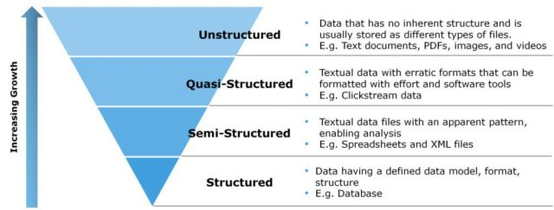
Types of Data – Conclusion

Slide 33
Types of Data – Conclusion
Structured data – It is the type of data that is stored in a relational databases such as SQL and Oracle where data is organized in rows and columns within named tables.
Semi-structured data – This type of data does not have a standard data model but it has clear self-describing patterns and structure. Examples of semi-structured data are Excel spreadsheets that have a row and column structure and XML files that are defined by an XML schema.
Quasi-structured Data – This type of data consists of textual content with erratic data formats, and its formatted with effort, software system tools, and time. An example of quasi-structured data is the data about webpages a user visited and in what order.
Unstructured Data – This type of data doesn’t have an information model and isn’t organized in any specific format. Some samples of unstructured data are e-mails, displays, images, text documents, PDF files and videos. Approx 90% of the digital data generated these days is non-structured data which is either semi-, quasi-, and unstructured data.

Slide 34
Pros and Cons of Structured Data
Pros | Cons
Requires less processing in comparison to unstructured data and is easier to manage. | Limited usability because of its pre-defined structure/format
Machine algorithms can easily crawl and use structured data which simplifies querying | Structured data is stored in data warehouses which are built for space saving but are difficult to change and not very scalable/flexible.
As an older format of data, there are several tools available for structured data that simplify usage, management, and analysis

Slide 35
Pros and Cons of Unstructured Data
Pros | Cons
Variety of native formats facilitate a greater number of use-cases and applications | The greater number of formats makes it equally challenging to analyze and leverage unstructured data.
As there is no need to predefine data, unstructured data is collected quickly and easily. | The large volume and undefined formats make data management a challenge and specialized tools a necessity.
Unstructured data is stored in on-premises or cloud data lakes which are highly scalable.
Although challenging, the greater volume of unstructured data provides better insights and more opportunities to turn your data into a competitive advantage.

Slide 36
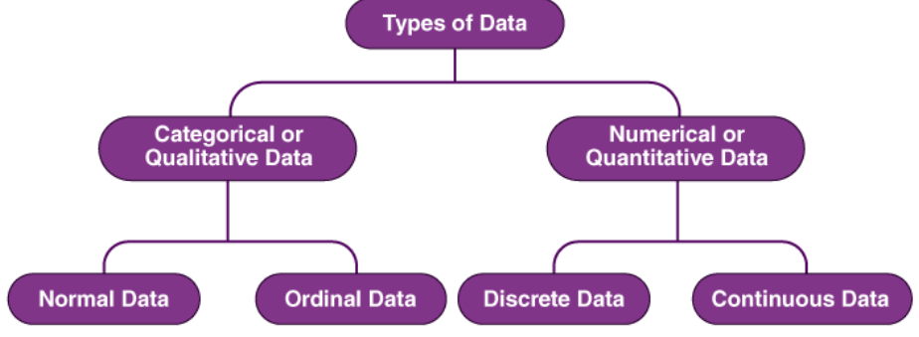
Types of Data : Qualitative and Quantitative data
While working on these data, it is important to know the types of data to process them and get the right results.
There are mainly two types of data: Qualitative and Quantitative data.

Slide 37
Types of Data
Qualitative or Categorical Data:-
Qualitative or Categorical Data is data that can’t be measured or counted in the form of numbers. These types of data are sorted by category, not by number. That’s why it is also known as Categorical Data. These data consist of audio, images, symbols, or text. The gender of a person, i.e., male, female, or others, is qualitative data.
Qualitative data tells about the perception of people. This data helps market researchers understand the customers’ tastes and then design their ideas and strategies accordingly.
The other examples of qualitative data are :
What language do you speak
Favorite holiday destination
Opinion on something (agree, disagree, or neutral)
Colors

Slide 38
Types of Data - Qualitative
The Qualitative data are further classified into two parts :
1. Nominal Data
Nominal Data is used to label variables without any order or quantitative value. The color of hair can be considered nominal data, as one color can’t be compared with another color.
The name “nominal” comes from the Latin name “nomen,” which means “name.” With the help of nominal data, we can’t do any numerical tasks or can’t give any order to sort the data. These data don’t have any meaningful order; their values are distributed into distinct categories.
Examples of Nominal Data :
Colour of hair (Blonde, red, Brown, Black, etc.)
Marital status (Single, Widowed, Married)
Nationality (Indian, German, American)
Gender (Male, Female, Others)
Eye Color (Black, Brown, etc.)

Slide 39
Types of Data - Qualitative
2. Ordinal Data
Ordinal data have natural ordering where a number is present in some kind of order by their position on the scale. These data are used for observation like customer satisfaction, happiness, etc., but we can’t do any arithmetical tasks on them.
Ordinal data is qualitative data for which their values have some kind of relative position. These kinds of data can be considered “in-between” qualitative and quantitative data. The ordinal data only shows the sequences and cannot use for statistical analysis. Compared to nominal data, ordinal data have some kind of order that is not present in nominal data.
Examples of Ordinal Data :
When companies ask for feedback, experience, or satisfaction on a scale of 1 to 10
Letter grades in the exam (A, B, C, D, etc.)
Ranking of people in a competition (First, Second, Third, etc.)
Economic Status (High, Medium, and Low)
Education Level (Higher, Secondary, Primary)

Slide 40
Types of Data – Difference between Nominal and Ordinal Data
Nominal Data | Ordinal Data
Nominal data can’t be quantified, neither they have any intrinsic ordering | Ordinal data gives some kind of sequential order by their position on the scale
Nominal data is qualitative data or categorical data | Ordinal data is said to be “in-between” qualitative data and quantitative data
They don’t provide any quantitative value, neither can we perform any arithmetical operation | They provide sequence and can assign numbers to ordinal data but cannot perform the arithmetical operation
Nominal data cannot be used to compare with one another | Ordinal data can help to compare one item with another by ranking or ordering
Examples: Eye color, housing style, gender, hair color, religion, marital status, ethnicity, etc | Examples: Economic status, customer satisfaction, education level, letter grades, etc

Slide 41
Types of Data - Quantitative
Quantitative Data
Quantitative data can be expressed in numerical values, making it countable and including statistical data analysis. These kinds of data are also known as Numerical data. It answers the questions like “how much,” “how many,” and “how often.” For example, the price of a phone, the computer’s ram, the height or weight of a person, etc., falls under quantitative data.
Quantitative data can be used for statistical manipulation. These data can be represented on a wide variety of graphs and charts, such as bar graphs, histograms, scatter plots, boxplots, pie charts, line graphs, etc.
Examples of Quantitative Data :
Height or weight of a person or object
Room Temperature
Scores and Marks (Ex: 59, 80, 60, etc.)
Time

Slide 42
Types of Data - Quantitative
The Quantitative data are further classified into two parts :
1. Discrete Data
The term discrete means distinct or separate. The discrete data contain the values that fall under integers or whole numbers. The total number of students in a class is an example of discrete data. These data can’t be broken into decimal or fraction values.
The discrete data are countable and have finite values; their subdivision is not possible. These data are represented mainly by a bar graph, number line, or frequency table.
Examples of Discrete Data :
Total numbers of students present in a class
Cost of a cell phone
Numbers of employees in a company
The total number of players who participated in a competition
Days in a week

Slide 43
Types of Data - Quantitative
2. Continuous Data
Continuous data are in the form of fractional numbers. It can be the version of an android phone, the height of a person, the length of an object, etc. Continuous data represents information that can be divided into smaller levels. The continuous variable can take any value within a range.
The key difference between discrete and continuous data is that discrete data contains the integer or whole number. Still, continuous data stores the fractional numbers to record different types of data such as temperature, height, width, time, speed, etc.
Examples of Continuous Data :
Height of a person
Speed of a vehicle
“Time-taken” to finish the work
Wi-Fi Frequency
Market share price

Slide 44
Types of Data – Difference between Discrete and Continuous Data
Discrete Data | Continuous Data
Discrete data are countable and finite; they are whole numbers or integers | Continuous data are measurable; they are in the form of fractions or decimal
Discrete data are represented mainly by bar graphs | Continuous data are represented in the form of a histogram
The values cannot be divided into subdivisions into smaller pieces | The values can be divided into subdivisions into smaller pieces
Discrete data have spaces between the values | Continuous data are in the form of a continuous sequence
Examples: Total students in a class, number of days in a week, size of a shoe, etc. | Example: Temperature of room, the weight of a person, length of an object, etc.

Slide 45
Types of Data - Quantitative
Working on data is crucial because we need to figure out what kind of data it is and how to use it to get valuable output out of it. It is also important to know what kind of plot is suitable for which data category; it helps in data analysis and visualization. Working with data requires good data science skills and a deep understanding of different types of data and how to work with them.
Different types of data are used in research, analysis, statistical analysis, data visualization, and data science. This data helps a company analyze its business, design its strategies, and help build a successful data-driven decision-making process.

Slide 46
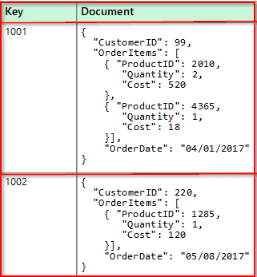
Examples of Non-Relational Data
Document Data Stores
A document data store handles a set of objects data values and named string fields in an entity referred to as a document.
These data stores generally store data in the form of JSON documents.

Slide 47
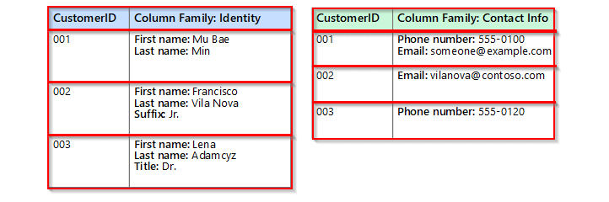
Examples of Non-Relational Data
Columnar Data Stores
A columnar or column-family data store construct data into rows and columns. The columns are divided into groups known as column families.
Each column family consists of a set of columns that are logically related and are generally retrieved or manipulated as a unit.
Within a column family, rows can be sparse and new columns can be added dynamically.

Slide 48
Examples of Non-Relational Data
Columnar Data Stores
A columnar or column-family data store construct data into rows and columns. The columns are divided into groups known as column families.
Each column family consists of a set of columns that are logically related and are generally retrieved or manipulated as a unit.
Within a column family, rows can be sparse and new columns can be added dynamically.

Slide 49
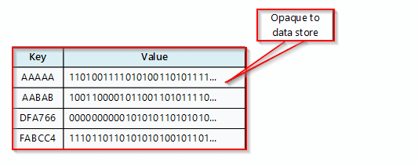
Examples of Non-Relational Data
Key/Value Data Stores
A key/value store is actually a large hash table.
We associate each data value with a unique key, and the key/value store uses this key to store the data by using a correct hashing function.
The hashing function is preferred to provide an even distribution of hashed keys across the data storage.
Key/value stores are highly suitable for applications operating simple lookups using the value of the by a range of keys.

Slide 50
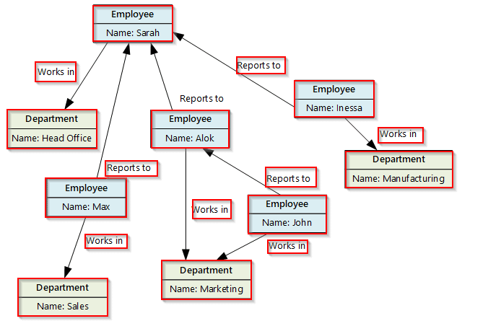
Examples of Non-Relational Data
Graph Data Stores
A graph data store handles two types of information, edges, and nodes.
Edges point out the relationships between these entities and Nodes represent entities.
The aim of a graph datastore is to grant an application to efficiently perform queries that traverse the network of edges and nodes and to inspect the relationships between entities.

Slide 51
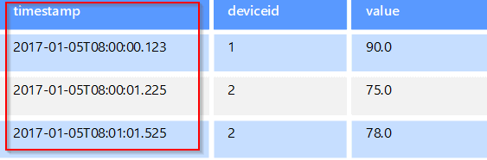
Examples of Non-Relational Data
Time series data stores
Time series data is a set of values formed by time, and a time-series data store is making the best for this type of data.
Time series data stores must support a very large number of writes, as they generally collect large amounts of data in real-time from a huge number of sources.

Slide 52
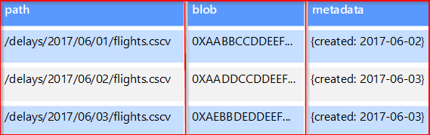
Examples of Non-Relational Data
Object data stores
Object data stores are correct for retrieving and storing large binary objects or blobs such as audio and video streams, images, text files, large application documents and data objects, and virtual machine disk images.
An object consists of some metadata, stored data, and a unique ID for access to the object.

Slide 53
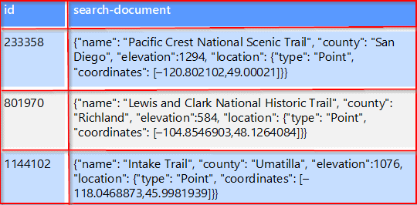
Examples of Non-Relational Data
External index data stores
External index data stores give the ability to search for information held in other data services and stores.
An external index acts as a secondary index for any data store. It can provide real-time access to indexes and can be used to index massive volumes of data.

Slide 54
Types of Data
What are the difference between Structured and Unstructured data?
1) Defined Vs Undefined Data
Structured data is undoubtedly a defined type of data in a structure.
Structured data lives in columns and rows and it can be mapped into pre-defined fields.
Unstructured data does not have a predefined data format, it is a collection of many types of varied data that are stored in their native formats.
2)Quantitative Vs Qualitative Data
Structured data is generally quantitative data, it usually consists of hard numbers or things that can be counted.
Methods for analysis include classification, regression, and clustering of data.
Unstructured data is generally categorized as qualitative data, and cannot be analyzed and processed using conventional tools and methods.
Understanding qualitative data requires advanced analytics techniques like data stacking and data mining.

Slide 55
3) Storage In Data Lakes Vs Data Houses
Structured data is generally stored in data warehouses.
Unstructured data is stored in data lakes.
Unstructured data requires more storage space, while structured data requires less storage space.
4) Ease Of Analysis
Structured data is easy to search, both for algorithms and for humans.
Unstructured data is more difficult to search and requires processing to become understandable.

Slide 56
Sources of Data in Data Science
There are several sources of data that can be used in Data Science:
Internal Data: Internal data refers to data that is generated or collected by an organization or company. Examples of internal data include sales data, customer data, and production data. This data is often stored in databases or data warehouses.
External Data: External data refers to data that is collected from sources outside of an organization or company. Examples of external data include social media data, weather data, and economic data. This data is often collected from third-party sources and can be obtained through APIs, web scraping, or data marketplaces.
Public Data: Public data refers to data that is made available to the public by governments or other organizations. Examples of public data include census data, crime data, and health data. This data can be accessed through data portals or other publicly available sources.
Sensor Data: Sensor data refers to data that is collected by sensors or other IoT devices. Examples of sensor data include temperature data, GPS data, and traffic data. This data is often collected in real-time and can be used to analyze patterns or detect anomalies.

Slide 57
Sources of Data in Data Science
Syndicated Data: Syndicated data refers to data that is collected and sold by research firms or data providers. Examples of syndicated data include market research data, consumer behavior data, and advertising data. This data is often used by companies for market research and competitive analysis.
Mobile Data: Mobile data refers to the data that is collected from mobile devices, such as smartphones and tablets. This data may include GPS data, app usage data, and call logs.
Customer Feedback: Customer feedback refers to the data that is collected from customer surveys, reviews, and feedback forms. This data is often used to improve products and services.
Historical Data: Historical data refers to the data that is collected over a long period of time. This data is often used to analyze trends and patterns in data.
Company Data: Companies often collect and store large amounts of data related to their operations, customers, and products. This data can be used for internal data science projects.
Web Data: The internet is a vast source of data, and web scraping can be used to extract data from websites for analysis.

Slide 58
Sources of Data in Data Science
Social Media Data: Social media platforms generate vast amounts of data that can be used for sentiment analysis, trend analysis, and other types of analysis.
IoT Data: The Internet of Things (IoT) generates data from connected devices such as sensors, wearables, and smart appliances. This data can be used for analysis and to develop predictive models.
Surveys: Surveys can be used to collect data from individuals or groups, and the data collected can be used for statistical analysis.
Government Data: Governments often collect and publish data related to various aspects of society, such as crime rates, health statistics, and environmental data.
Transactional data: Transactional data refers to data that is generated as part of a transaction, such as sales data or financial data.
Big data: Big data refers to data that is too large and complex to be processed using traditional data processing methods. It typically requires specialized tools and techniques.

Slide 59
What Is Big Data
Big data refers to extremely large and complex data sets that cannot be easily managed, processed, or analyzed using traditional data processing methods. These data sets typically include a wide range of structured and unstructured data, such as text, images, videos, and sensor data, and may come from a variety of sources, such as social media, IoT devices, financial transactions, scientific research, and more.
The main challenge of big data is to extract meaningful insights and valuable information from the data, which requires advanced analytics tools and techniques, such as machine learning, data mining, and natural language processing.
Big data is used in a wide range of applications, including business intelligence, marketing, healthcare, finance, security, and more.

Slide 60
What Is Big Data
Big Data is a collection of data that is huge in volume, yet growing exponentially with time.
It is data with so large size and complexity that none of the traditional data management tools can store it or process it efficiently.
With the growth of technologies and services, this large data is produced that can be structured, semi-structured, and unstructured from different sources.

Slide 61
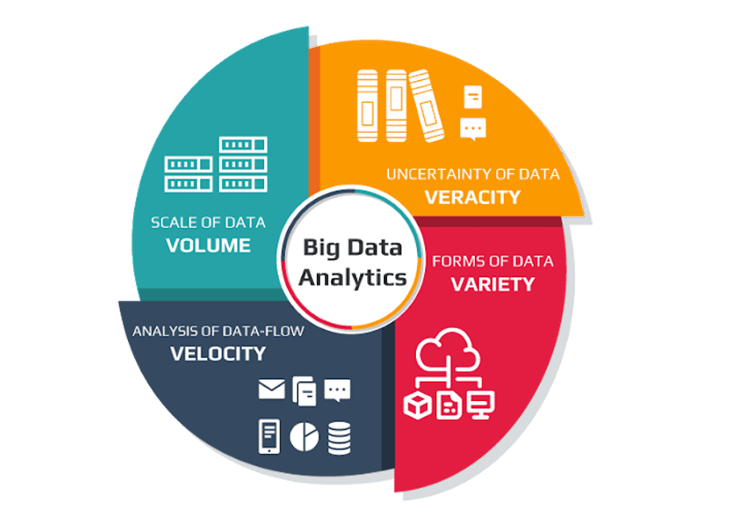
What Is Big Data
Characteristics Of Big Data
Big data can be described by the following characteristics:

Slide 62
Characteristics Of Big Data
1. Volume: This Volume Presents the most immediate challenge to conventional IT structures. This is the aspect that comes to people’s minds when they think of big data. Many companies already have large amounts of archived data in the form of logs, but do not have the capacity to process the data. The benefit gained from the ability to process a large amount of information is the main attraction of big data analytics.
2. Variety: Variety refers to heterogeneous sources and the nature of data, both structured and unstructured. During earlier days, spreadsheets and databases were the only sources of data considered by most of the applications. Nowadays, data in the form of emails, photos, videos, monitoring devices, PDFs, audio, etc. are also being considered in the analysis applications. This variety of unstructured data poses certain issues for storage, mining and analyzing data.
3. Velocity: The speed at which the data is generated and processed to meet the demands and challenges that lie in the path of growth and development. Big data is often available in real-time. Compared to small data, big data are produced more continually. Two kinds of velocity related to big data are the frequency of generation and the frequency of handling, recording, and publishing.

Slide 63
Characteristics Of Big Data
4. Veracity: When we are dealing with a high volume, velocity, and variety of data, it is not possible that all of the data is going to be 100 % correct. There will be dirty data also. The quality of the data being captured can vary greatly. The data accuracy of the analysis depends on the variety of the source data.
Verify if the data is suitable for its purpose and usable within the analytic model.
Decide if it is trustworthy to analyze this data against a set of defined criteria.
Capture the business procedures that enable the data to be profiled and validated.
If the problems are identified, undertake the right activities to remediate the data before any analysis is performed.

Slide 64
Characteristics Of Big Data
While the four V’s described earlier help understand Big Data from a technical prospective, there is another ‘V’ model that helps understand the same from a business perspective.
These include:
5. Variability: Examine the datasets more closely. Establish if the contextual structure of the data stream is regular and dependable. Decide how the nature and context of text data content can be interpreted in a way that becomes meaningful for the required business analytic-ready models.
6. Value: Identify the purpose, scenario, or business benefit that the analytic solution seeks to address. Thoroughly analyze what is the possible outcome and what is the desired outcome of the analysis. What actions need to be taken to get the desired results? Ensure that the analysis to be performed meets ethical considerations without reputation or compliance implications.

Slide 65
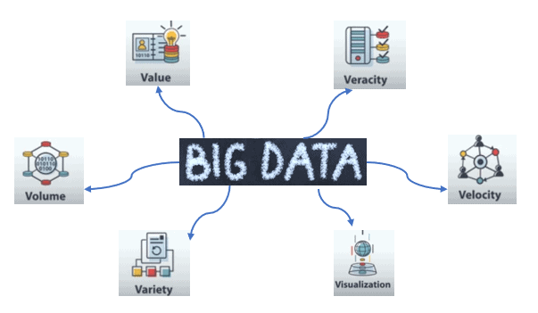
What Is Big Data

Slide 66
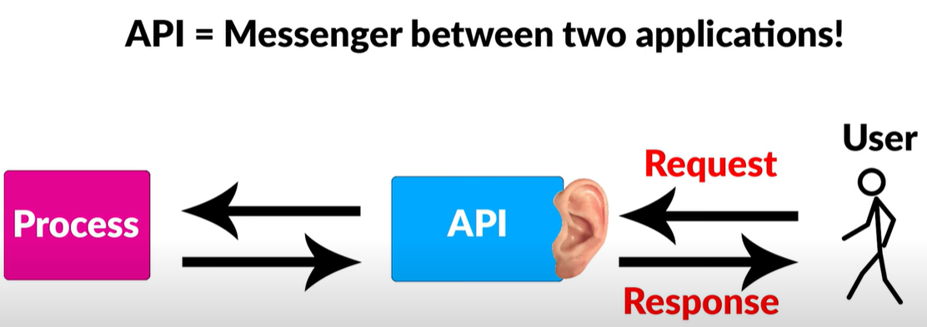
Data Collection and APIs in Data Science
APIs, or application programming interfaces, are a set of protocols, routines, and tools for building software applications. In data science, APIs can be used to access and integrate various sources of data, such as databases, web services, and social media platforms.
APIs can be used to extract data from external sources and integrate it into a data science project. For example, a data scientist may use an API to access data from a social media platform like Twitter, extract relevant information such as hashtags and user mentions, and analyze the data to gain insights into user behavior or sentiment.

Slide 67
Data Collection and APIs in Data Science
APIs can also be used to build machine learning models that can be deployed in production. For example, a data scientist may use an API to train a model on a large dataset, and then expose the model as an API that can be accessed by other applications or services.
APIs can help data scientists save time and resources by automating repetitive tasks and integrating various data sources into a single workflow. They also enable collaboration between different teams and departments, as well as between different applications and services.
APIs are a powerful tool for data scientists to access, process, and analyze data from various sources, making it easier to perform data-driven tasks and derive insights.

Slide 68
Data Collection and APIs in Data Science
Data science APIs provide an interface that enables users to interact with data and perform various operations such as data retrieval, transformation, analysis, and visualization. These APIs can be categorized into several types, including web APIs, cloud APIs, and machine learning APIs.
Web APIs provide access to web-based data sources such as social media platforms, weather data, news, and financial information. For instance, the Twitter API allows data scientists to retrieve tweets for analysis, while the OpenWeatherMap API provides access to weather data.
2. Cloud APIs provide access to cloud-based services, such as storage, computing, and data analytics. For instance, Amazon Web Services (AWS) provides APIs for accessing its cloud-based computing infrastructure and data storage services.
3. Machine learning APIs provide pre-built models for performing various machine learning tasks, such as image recognition, natural language processing, and sentiment analysis. These APIs allow data scientists to avoid the time-consuming and resource-intensive process of building models from scratch.

Slide 69
Exploring and Fixing data
Exploring and fixing data is a critical step in data science, as it ensures that the data used in analysis is accurate, complete, and reliable leading to more accurate insights and better decision-making.
Here are some common techniques for exploring and fixing data:
Data cleaning: This involves identifying and correcting errors and inconsistencies in the data. Data cleaning techniques include removing duplicates, handling missing values, correcting data types, and identifying outliers.
Data normalization: This involves transforming data into a standard format to remove redundancies and inconsistencies. For instance, converting date formats to a standard format.
Data visualization: This involves creating visual representations of data to identify patterns, trends, and anomalies. Data visualization techniques include scatter plots, line charts, histograms, and box plots.
Statistical analysis: This involves using statistical methods to analyze the data and identify patterns and trends. Statistical analysis techniques include regression analysis, hypothesis testing, and ANOVA.
Data transformation: This involves converting data into a usable format, such as converting categorical variables into numerical variables or normalizing data to ensure consistency.

Slide 70
Data Storage and Management
Data storage and management are important aspects of data science that involve storing, organizing, and maintaining large volumes of data in a way that is efficient and accessible for analysis. There are several approaches to data storage and management in data science, including databases, data warehouses, and data lakes.
Databases are a common storage option in data science, providing a structured way to store and manage data. They are designed to efficiently store and retrieve data using SQL (Structured Query Language) and can be relational or non-relational. Relational databases use a table-based structure to store data, while non-relational databases use a document-based or key-value structure.
Data warehouses are designed to store large volumes of data from multiple sources and organize it in a way that facilitates analysis. They are typically used for business intelligence and reporting and support complex queries and data aggregations.

Slide 71
Data Storage and Management
Data lakes are a newer storage option that provide a centralized repository for storing raw, unstructured data. Data lakes can store data in its original form and can be accessed and analyzed using various tools and technologies.
In addition to data storage, data management is also a critical component of data science.
Data Management involves ensuring data quality, data governance, and data security.
Data quality involves ensuring that data is accurate, complete, and consistent, while data governance involves establishing policies and procedures for managing data, including data quality, data ownership, and data privacy. Data governance ensures that data is managed in a consistent and compliant manner.
Data security involves implementing measures to ensure that data is protected from unauthorized access, breaches or theft. This can be achieved through encryption, access controls, and regular backups..

Slide 72
using multiple data sources
Using multiple data sources is a common practice in data science that can help improve the accuracy and comprehensiveness of analysis. Combining data from different sources allows data scientists to gain insights that may not be apparent from a single data source alone.
Here are some ways to use multiple data sources in data science:
Data integration: This involves combining data from different sources into a single dataset. For example, a data scientist may combine customer data from a CRM system with social media data to gain a more comprehensive view of customer behavior.
Data fusion: This involves combining data from different sources to create a more detailed and accurate view of a specific phenomenon. For example, a data scientist may fuse data from sensors, weather forecasts, and social media data to analyze the impact of weather on consumer behavior.
Data enrichment: This involves enhancing existing data with additional information from external sources. For example, a data scientist may enrich customer data with demographic data to gain a better understanding of their target audience.

Slide 73
using multiple data sources
Data triangulation: This involves using multiple sources of data to validate or verify findings. For example, a data scientist may use sales data, customer feedback, and social media data to validate the success of a marketing campaign.
Data augmentation: This involves using data from one source to enhance or supplement data from another source. For example, a data scientist may use satellite imagery to supplement weather data to analyze the impact of climate change on agriculture.
Data compatibility: When using multiple data sources, it is important to ensure that the data is compatible and can be integrated. This requires identifying any differences in data formats, variables, and units of measurement and converting them into a standard format.

Slide 74
using multiple data sources
Data quality: Each data source may have different levels of quality, accuracy, and reliability. Data scientists need to evaluate the quality of each data source and determine the appropriate weighting for each source in the analysis.
Data volume: Combining multiple data sources can result in a large volume of data, which can increase the complexity of data analysis. Data scientists need to use appropriate tools and techniques, such as data warehousing, data lakes, and big data analytics, to manage and analyze large volumes of data.
Data privacy and security: Combining data from multiple sources can raise privacy and security concerns, particularly when dealing with sensitive or confidential data. Data scientists need to implement appropriate data security and privacy measures to protect the data and ensure compliance with regulations.

